Slide 2
Review Tutorial 1
Session 9
The basic counting methods
Counting using sets
Probability
4.1 The basic counting methods
4.1.1 Counting in which order is important (Permutations)
4.1.2 Counting in which order is not important. (Combinations)
4.1.3 Summary of strategies for counting problems
4.2 Counting using sets
4.3 Probability
4.3.1 Independent events

Slide 3
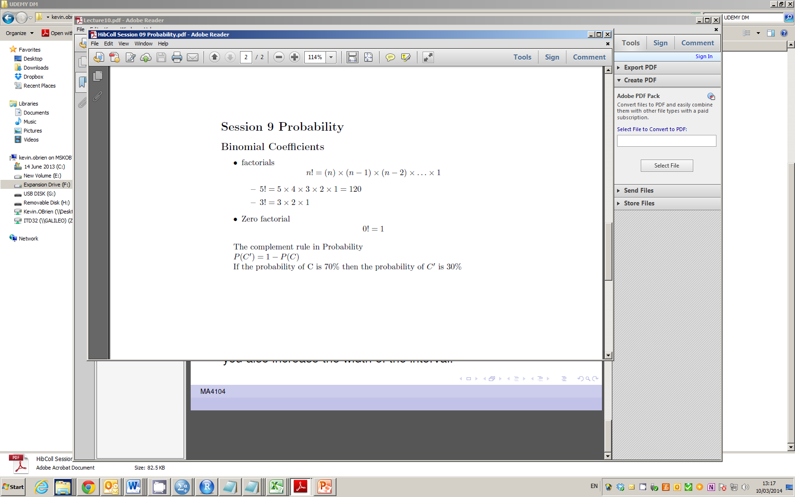
Factorials

Slide 4
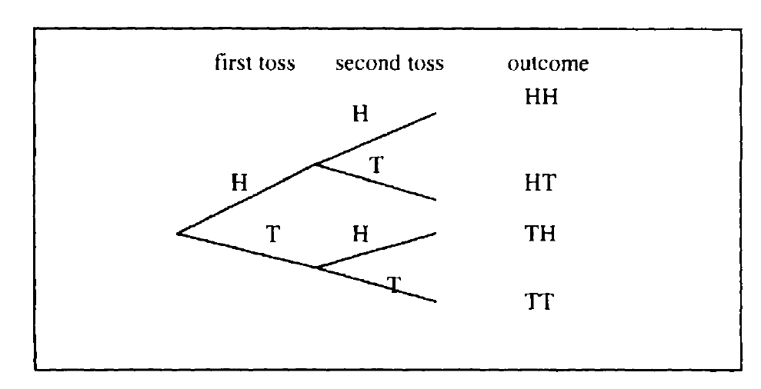
Multiplication Principle (Remark on Ordering)

Slide 5
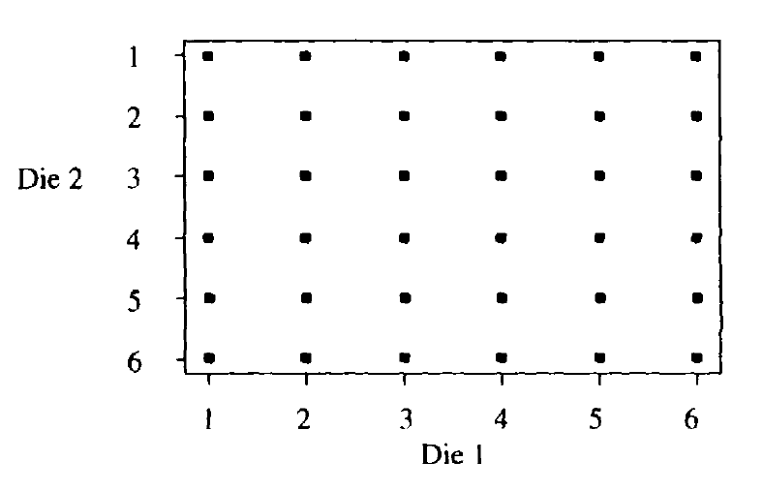
Multiplication Principle (Remark on Ordering)

Slide 6
Combinations and Permutations
If the order doesn't matter, it is a Combination.
If the order does matter it is a Permutation.
A Permutation is an ordered Combination.
There are basically two types of permutation:
Repetition is Allowed: PIN Numbers - could be "3133".
No Repetition: for example the first three people in a running race. A runner can't be first and second.

Slide 7
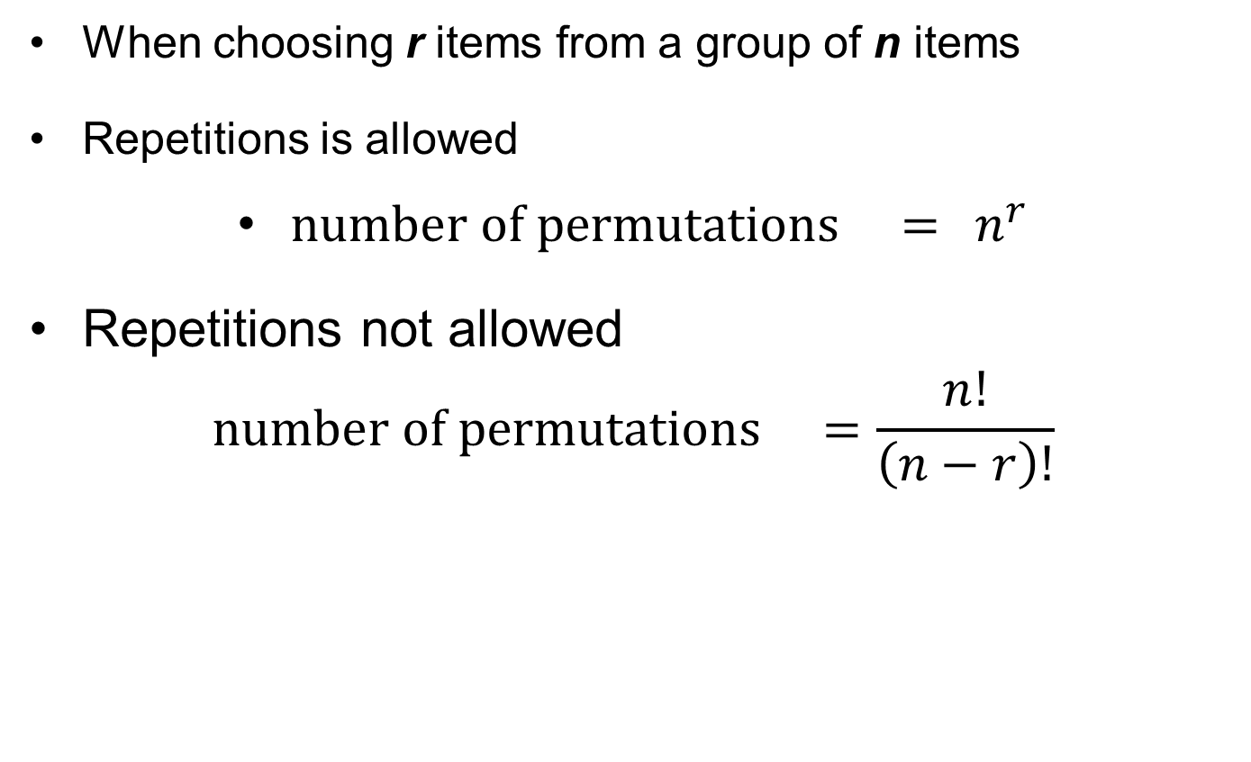
Permutations
When choosing r items from a group of n items
Repetitions is allowed
$number of permutations ={ n}^{r}$
Repetitions not allowed
$$number of permutations =\frac{n!}{\left(n−r\right)!}$$

Slide 8
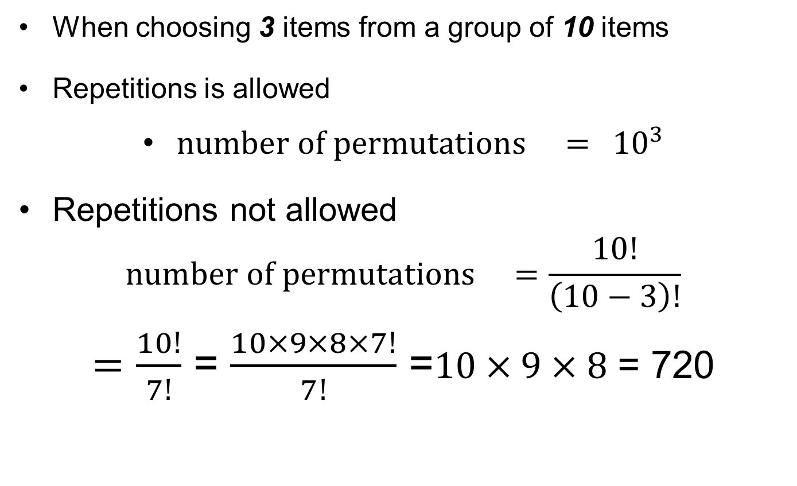
Permutations
When choosing 3 items from a group of 10 items
Repetitions is allowed
$number of permutations ={ 10}^{3}$
Repetitions not allowed
$$number of permutations =\frac{10!}{\left(10−3\right)!}$$
$=\frac{10!}{7!}$ = $\frac{10×9×8×7!}{7!}$ =$10×9×8$ = 720

Slide 9
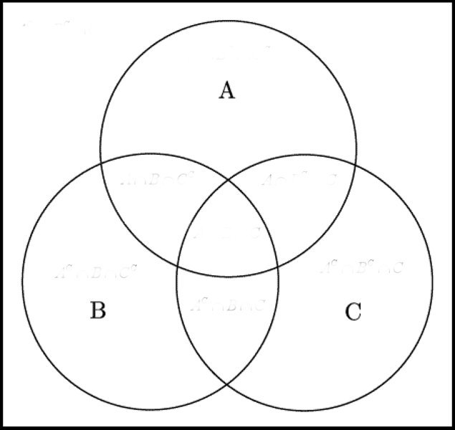
Venn Diagrams

Slide 10
Venn Diagrams
300 People
100 Americans
140 Boys
80 Cyclists
40 American Cyclists
50 Boy Cyclists
60 American Boys
20 American Boy
Cyclists

Slide 11
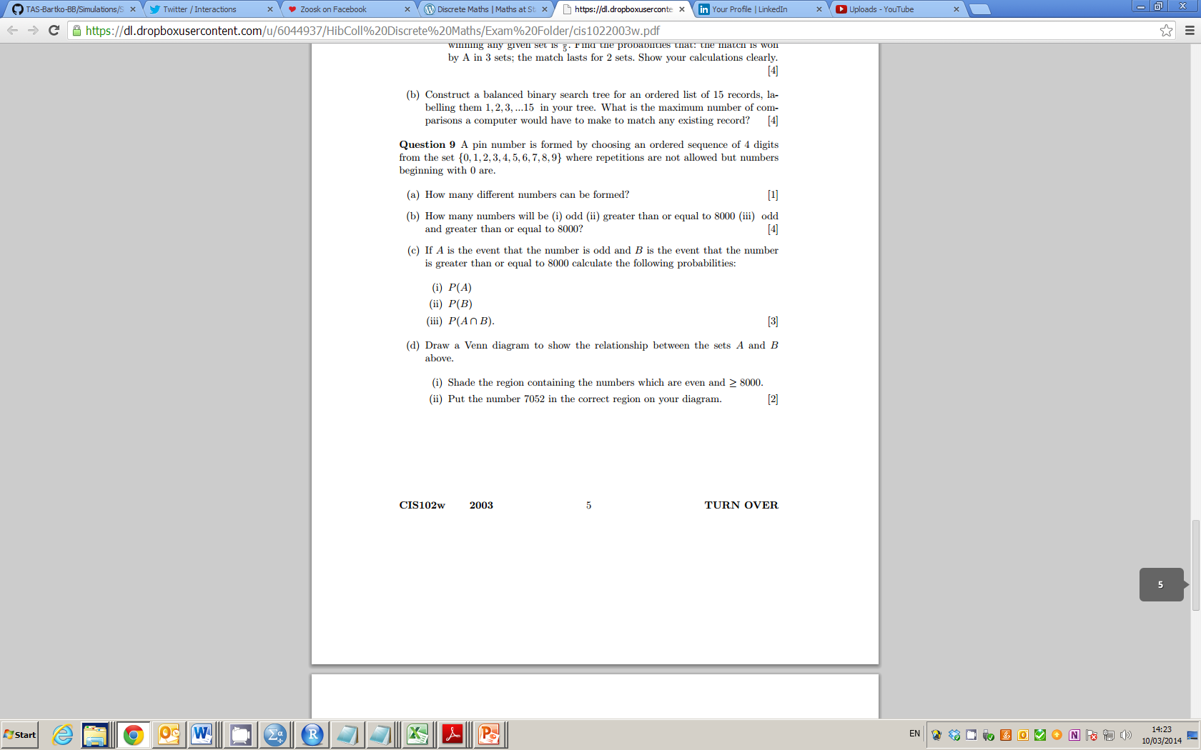
2009 Question 9

Slide 12
2009 Question 9

Slide 13
2009

Slide 14
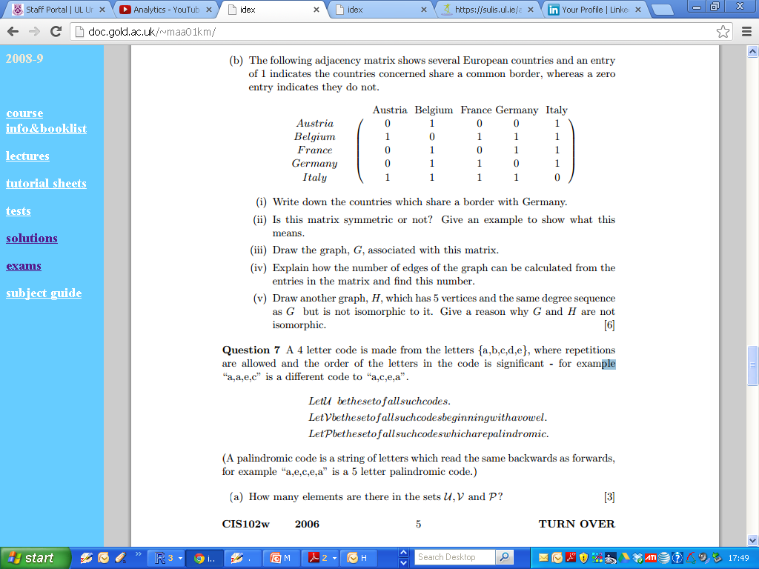
2006 Zone B Q7

Slide 15
2006 Zone B Q7

Slide 16
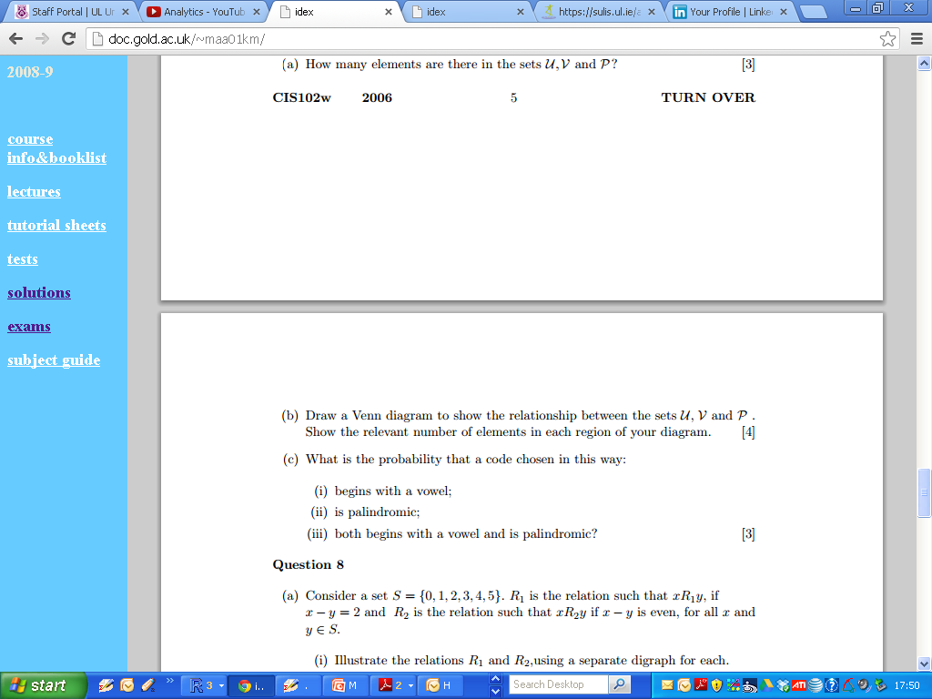
2006 Zone B Q7

Slide 17
2006 Zone B Q7

Slide 18
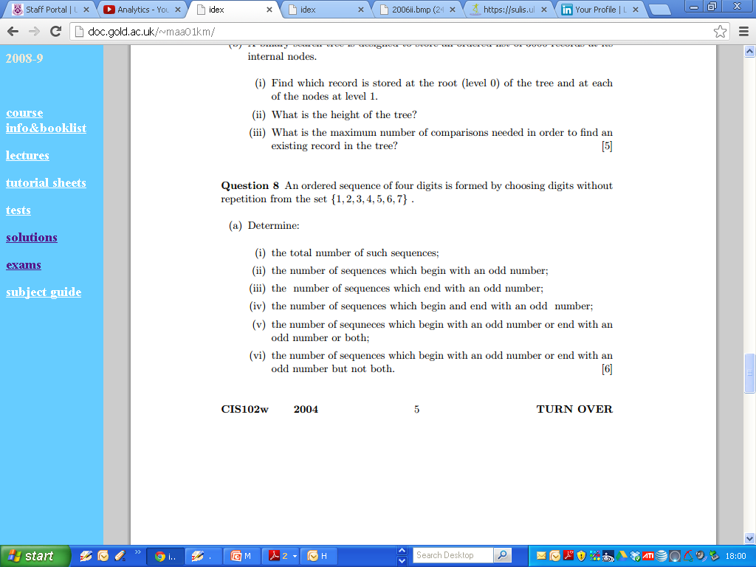
2004 Question 8

Slide 19
2004 Question 8

Slide 20
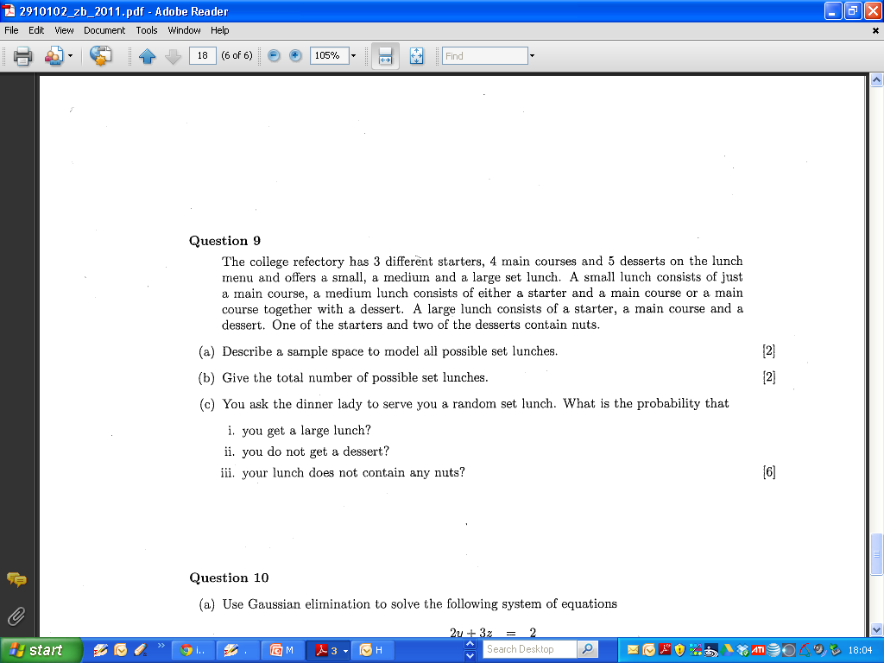
2011 Question 9

Slide 21
2011 Question 9

Slide 22
2011 Question 9

Slide 23
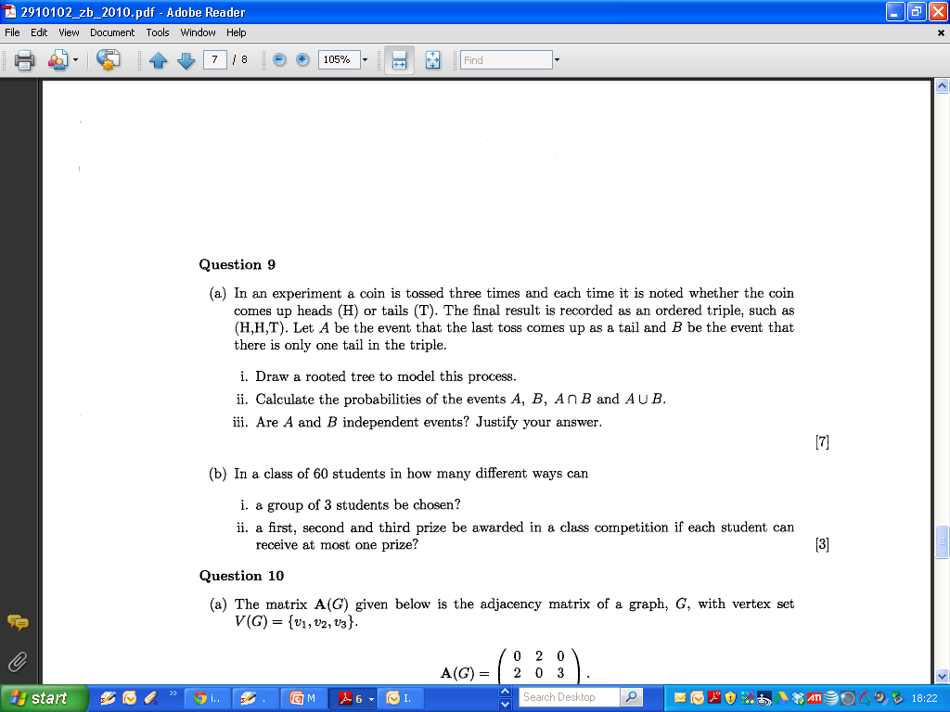
2010

Slide 24
2010 Zone B

Slide 25
2010 Zone B

Slide 26
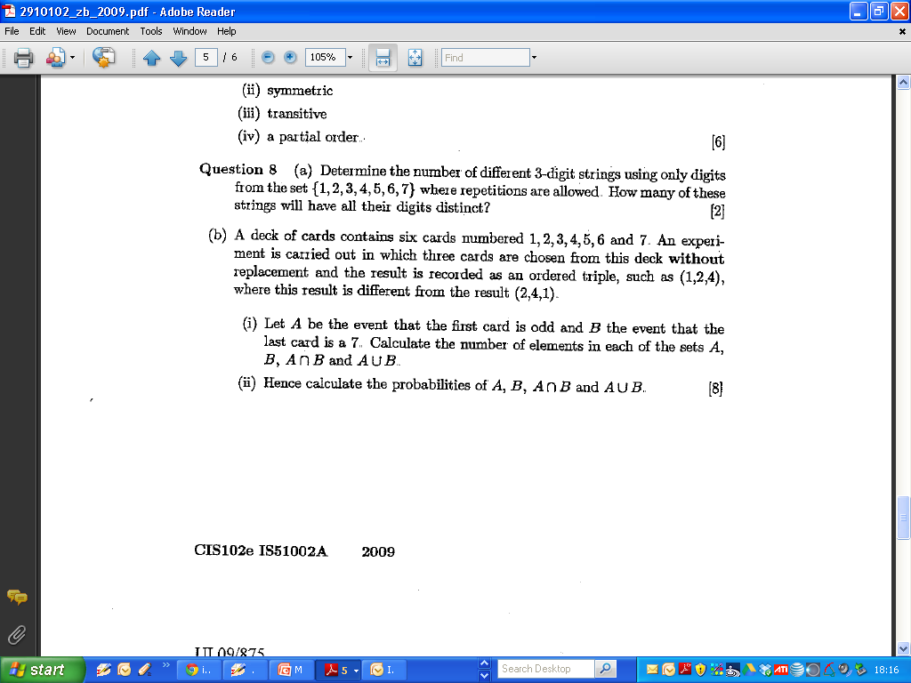
2009 Zone B

Slide 27
2009 Zone B

Slide 28
2009 Zone B

Slide 29
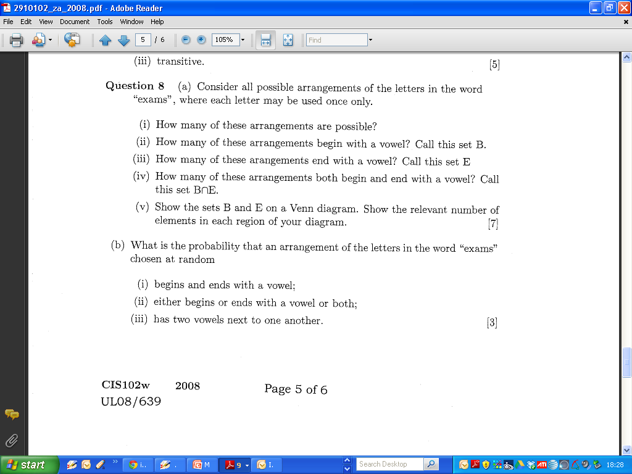
2008 Zone A

Slide 30
2008 Zone A

Slide 31
2008 Zone A

